Slide 1
Java Collections
Valentinus silalahi
2018

Slide 2
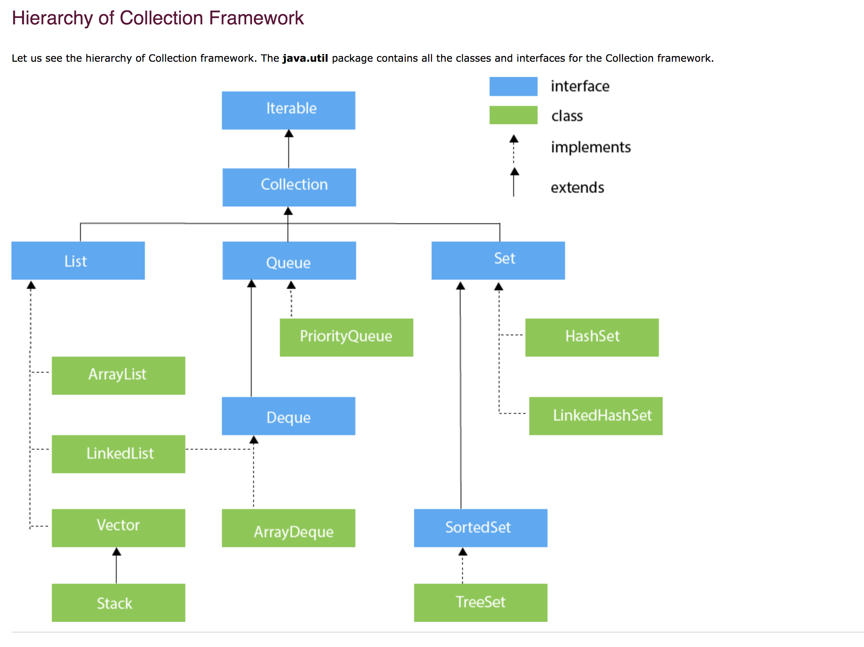
Collections in Java
2019 || Java Fundamental Batch-4

Slide 3
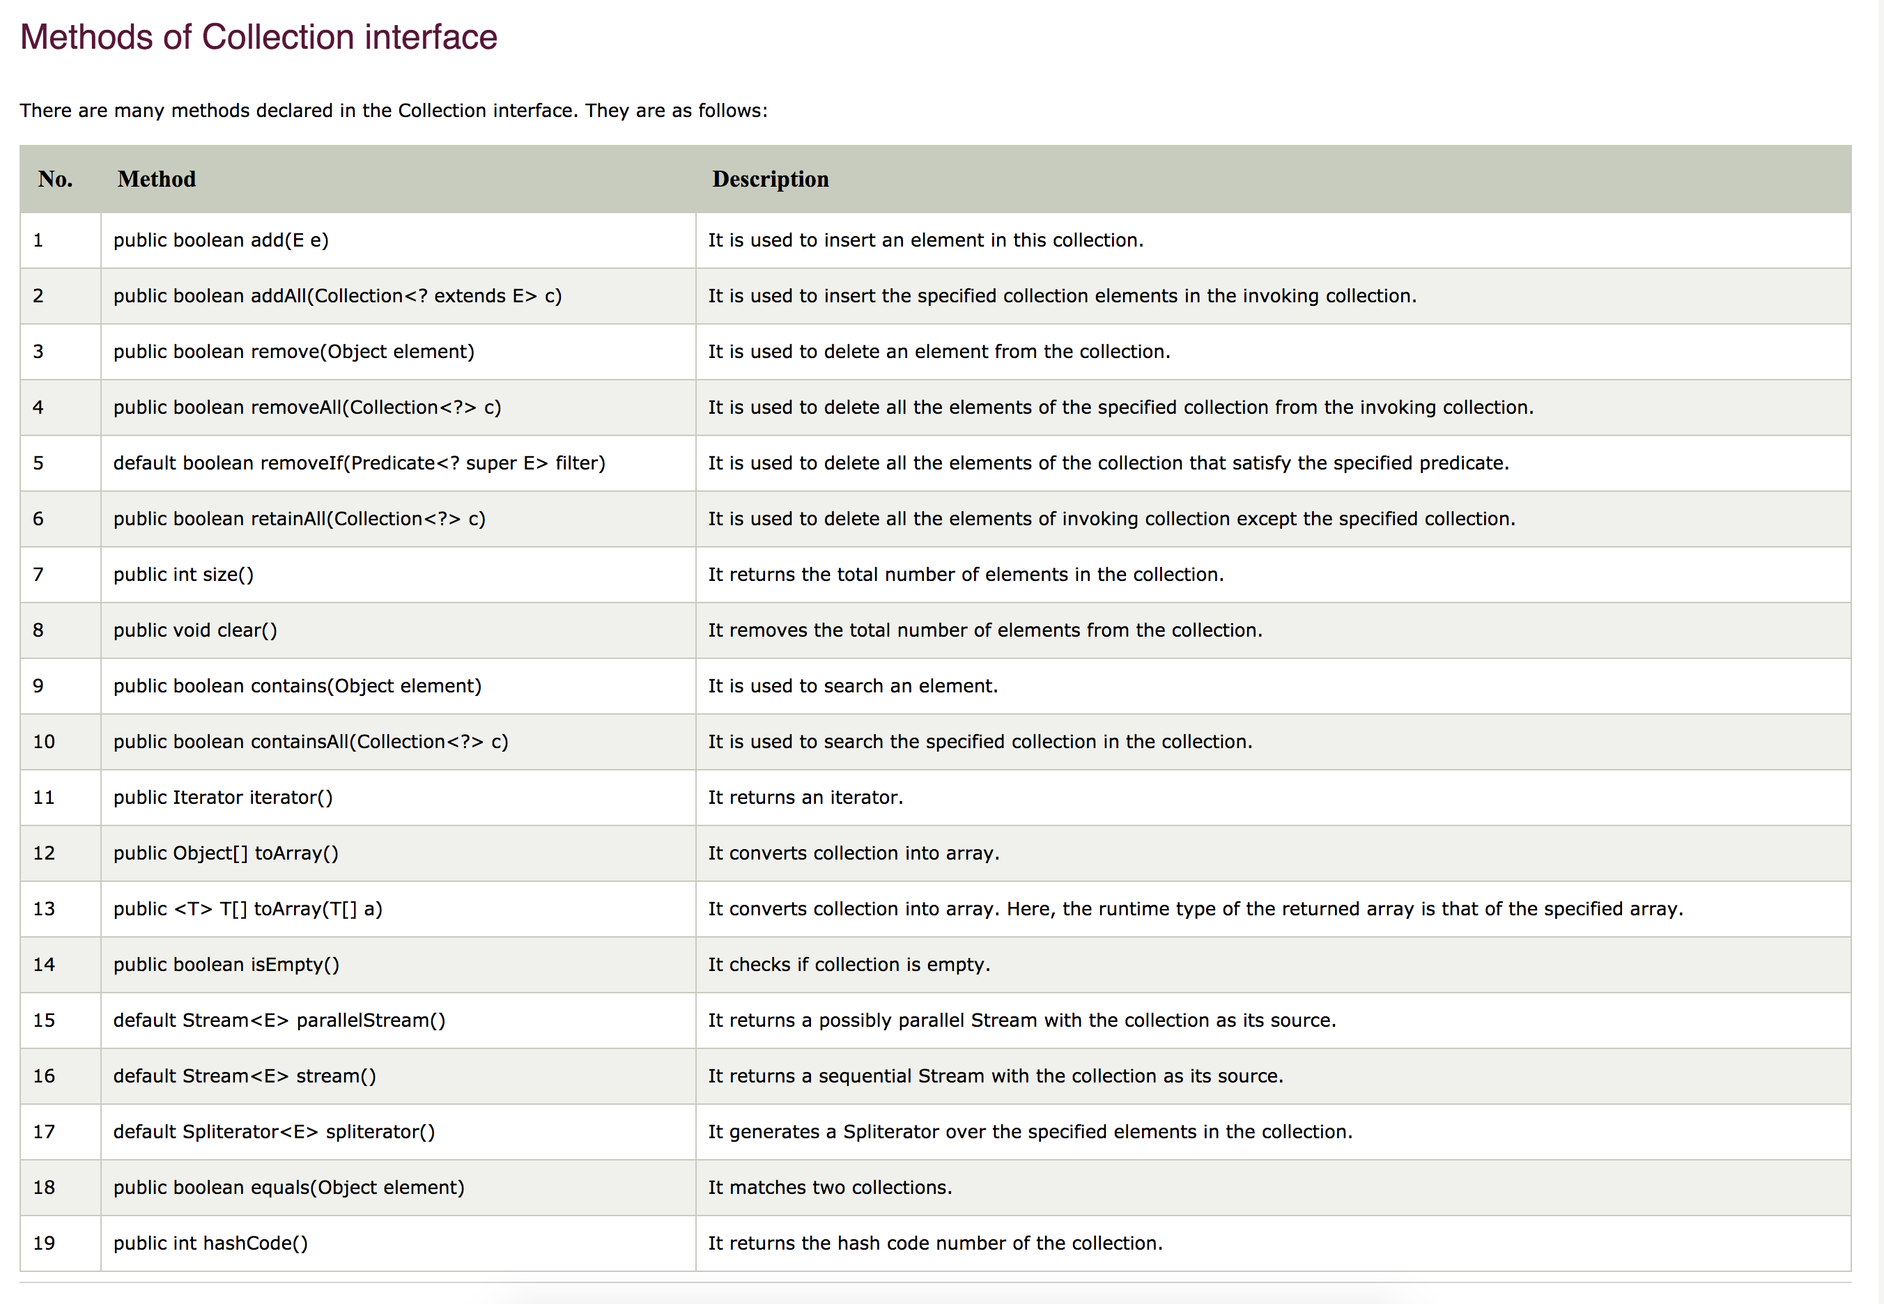
Collections in Java
2019 || Java Fundamental Batch-4

Slide 4
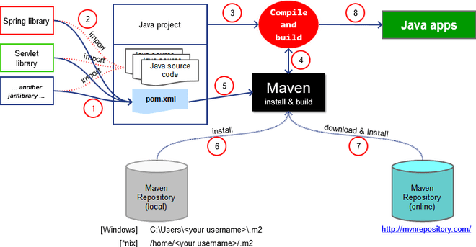
What is Maven?
2018

Slide 5
Let’s code!
2018

Slide 6
Installing Maven
check maven already exist: mvn --version
download on: http://maven.apache.org/download.cgi
tar -xvf apache-maven-3.5.2-bin.tar.gz
vi ~/.bash_profile
export M2_HOME=/Users/syahrulfathi/apache-maven-3.5.2
export PATH=$PATH:$M2_HOME/bin
export JAVA_HOME=/Library/Java/JavaVirtualMachines/jdk1.7.0_80.jdk/Contents/Home
mvn -version
2018

Slide 7
Maven Configuration
cd /Users/syahrulfathi/library/apache-maven-3.5.2/conf/
vi settings.xml
<mirrors>
<mirror>
<id>nexus</id>
<name>DOKU Nexus Server</name>
<mirrorOf>*</mirrorOf>
<url>http://nexus.doku.com/repository/maven-public/</url>
</mirror>
</mirrors>
2018

Slide 8
Maven Configuration
<profiles>
...
<profile>
<id>nexus</id>
<activation>
<activeByDefault>true</activeByDefault>
</activation>
<repositories>
<repository>
<id>central</id>
<url>http://central</url>
<releases><enabled>true</enabled></releases>
<snapshots><enabled>true</enabled></snapshots>
</repository>
</repositories>
<pluginRepositories>
<pluginRepository>
<id>central</id>
<url>http://central</url>
<releases><enabled>true</enabled></releases>
<snapshots><enabled>true</enabled></snapshots>
</pluginRepository>
</pluginRepositories>
</profile>
</profiles>
2018

Slide 9
Reference
https://maven.apache.org/
https://spring.io/guides/gs/maven/
http://confluence.doku.com/display/PD/Prepare+Maven
2018

Slide 10
Thank You
Syahrul Fathi
2017

